Slide 1
Digital Circuits and Systems Lecture 2-3 Model Finite State Machine
Tian Sheuan Chang
有了記憶，人生變彩色

Slide 2
Sequential circuit

Slide 3
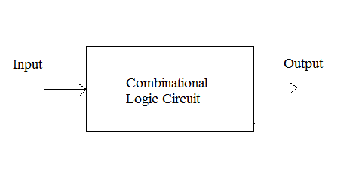
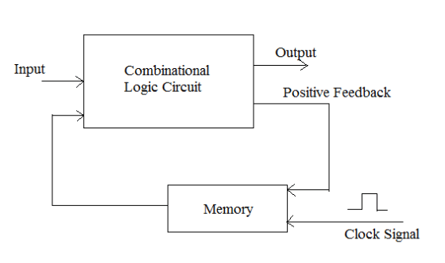
Sequential logic has state
Output = f(input)
Combinational Logic
Sequential Logic
*without storage elements, the
CL circuits with feedback may
Become unstable! => oscillator

Slide 4
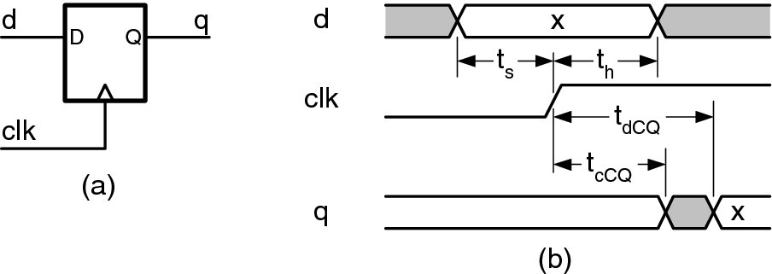
D Flip-Flop
Input: D
Output: Q
Clock
Q outputs a steady value
changes Q to be D at clock edge
Flip-flop stores state
Allows sequential circuits to iterate
*D-type FF is often exploited
as “register” due to simple connectivity;
Latch is exploited as well but level sensitive;
thus only half period is available.
一般數位電路不用latch
Why?

Slide 5
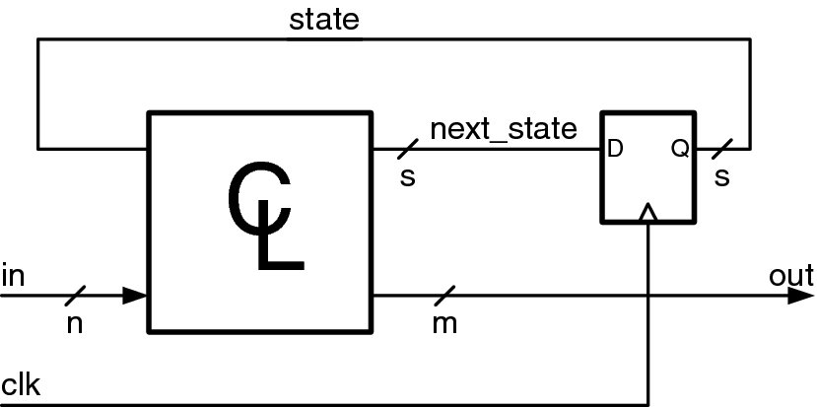
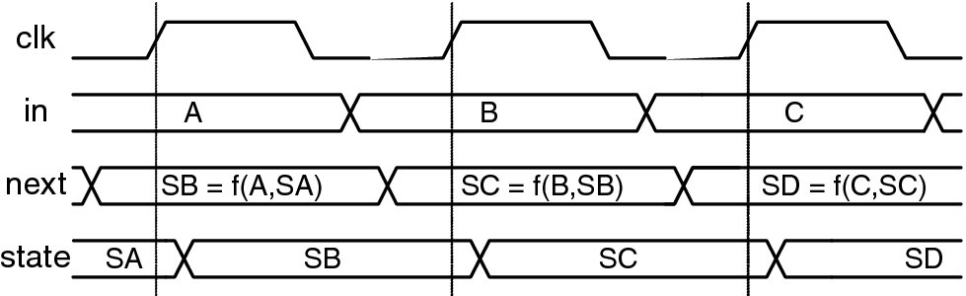
Timing Diagram of Sequential Circuit
輸入變，輸出就跟著變
輸入變，輸出等到
Clock edge 才變

Slide 6
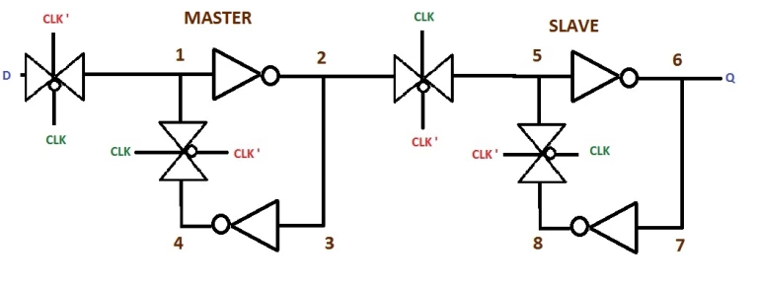
Timing Diagram of Sequential Circuit
Setup time: inputs become stable before rising clock;
Hold time: inputs remain stable after rising clock;
Setup time
Hold time

Slide 7
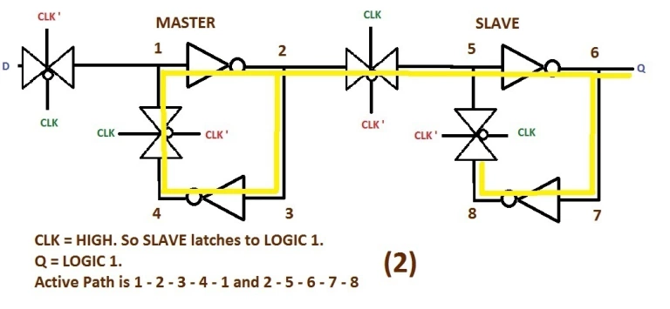
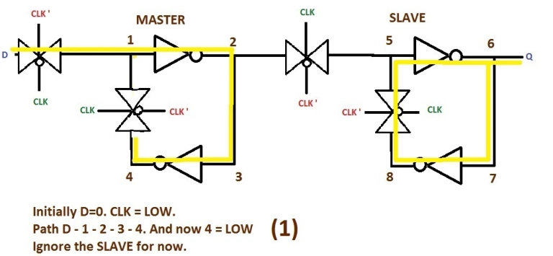
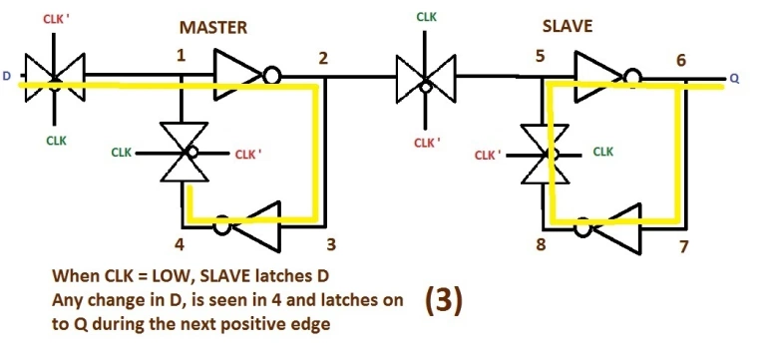
Setup time
Hold time
Hold time
要讓輸入資料穩定到達第二個 feedback loop的控制gate
Setup time: 要讓輸入資料穩定到達第一個
feedback loop的控制gate
Notes:
https://allthingsvlsi.wordpress.com/2013/04/17/d-flip-flop-operation-positive-edge-triggered/

Slide 8
Coding style for FSM
Source: C. Cummings, Synthesizable Finite State Machine Design Techniques
Using the New SystemVerilog 3.1 Enhancements

Slide 9
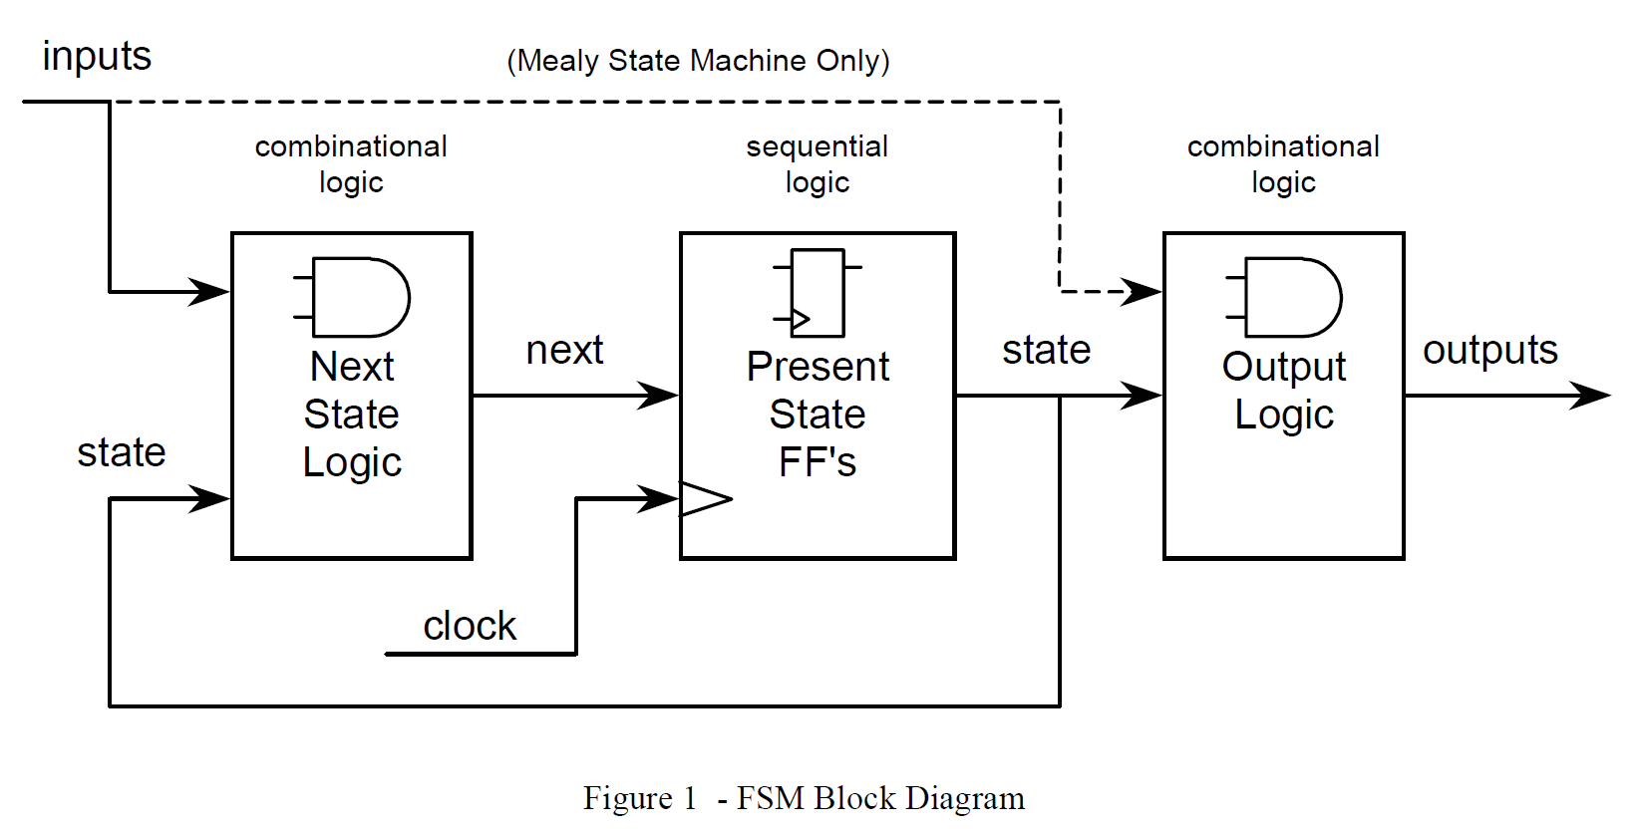
Moore v.s. Mealy
Mealy and Moore FSM
A Moore FSM is a state machine where the outputs are only a function of the present state.
A Mealy FSM is a state machine where one or more of the outputs is a function of the present state and one or more of the inputs.

Slide 10
Moore v.s. Mealy
FSM coding
Next state logic
Output logic
Present state DFF
Notes:
建議輸出最好是經過DFF，合成電路或接下一級電路較容易

Slide 11
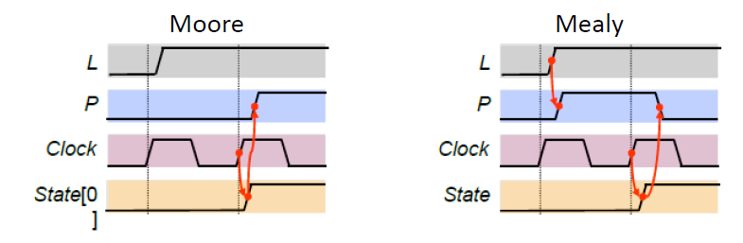
FSM Implementation: Moore/Mealy trade-off
Remember that the difference is in the output:
Moore outputs are based on state only
Mealy outputs are based on state and input
Therefore, Mealy outputs generally occur one cycle earlier than a Moore
Compared to a Moore FSM, a Mealy FSM might...
Be more difficult to conceptualize and design
Have fewer states

Slide 12
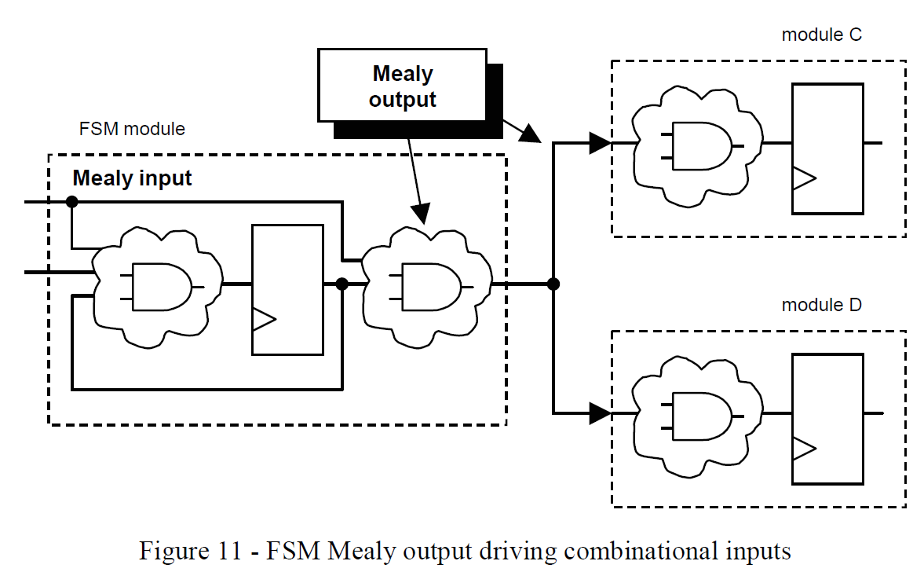
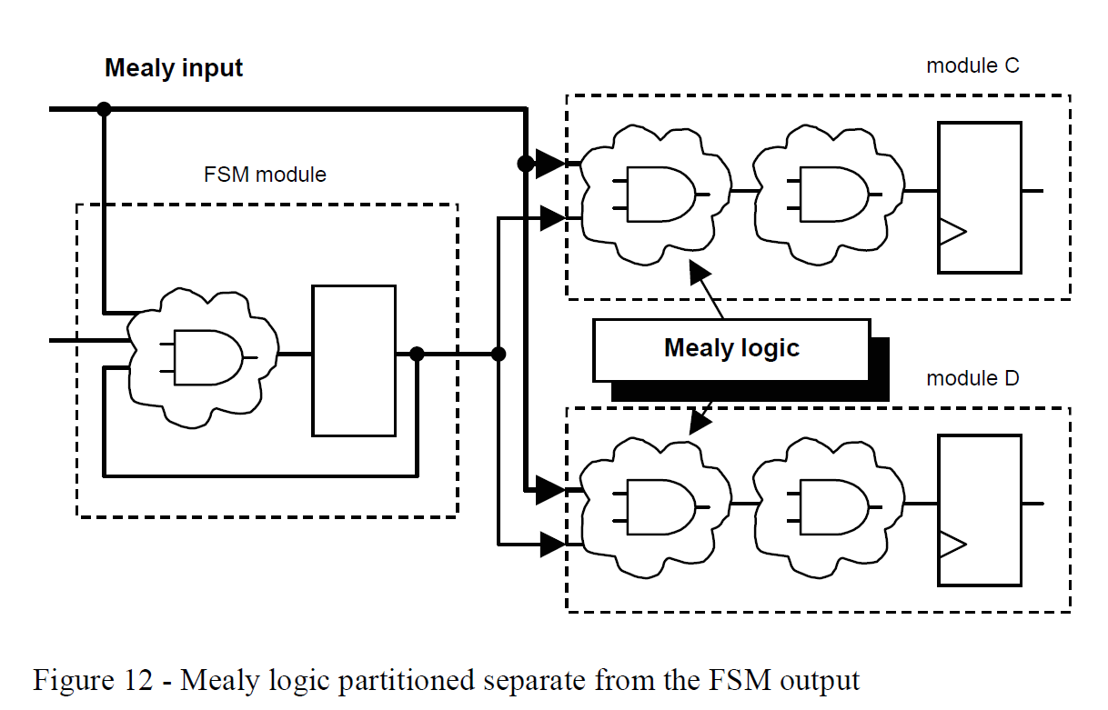
Asynchronous Mealy
Registered output to ease logic synthesis
Logic will not be minimized across module boundaries unless specified in synthesis tools
Notes:
(輸出和輸入與state有關)

Slide 13






FSM: Simple Moore Machine Example
4-State Moore State Machine
!rst_n
go=0
Asynchronous low-true reset
rst_n
IDLE
rd=0 ds=0
go=1
Clock signal name
clk
DONE
READ
rd=1 ds=0
rd=0 ds=1
Two inputs
go, ws
(wait-state)
ws
=0
DLY rd=1 ds=0
Two Moore outputs
rd, ds (read & done-strobe) (rd=0 & ds=0 on reset)
ws=1
Notes:
想一下；該如何做
State 要存，=> DFF, => sequential logic
輸入造成state 變化 => combinational logic
State 造成輸出變化 => combinational logic

Slide 14









Moore State Machine Two Always Blocks
Next state and output logic use one always_comb block
Present state FF use always_ff
Next State combinational logic
Clocked Present State logic
Output combinational logic
inputs
combinational logic
sequential logic
combinational logic
next
state
outputs
Next
Present
Output Logic
state
State
State FF's
Logic
clock

Slide 15
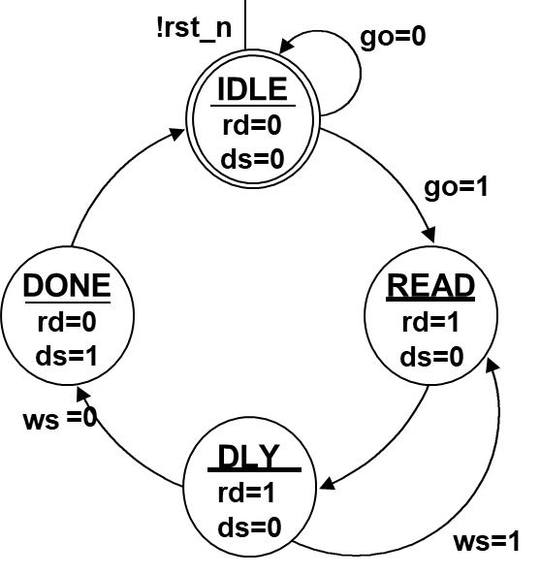
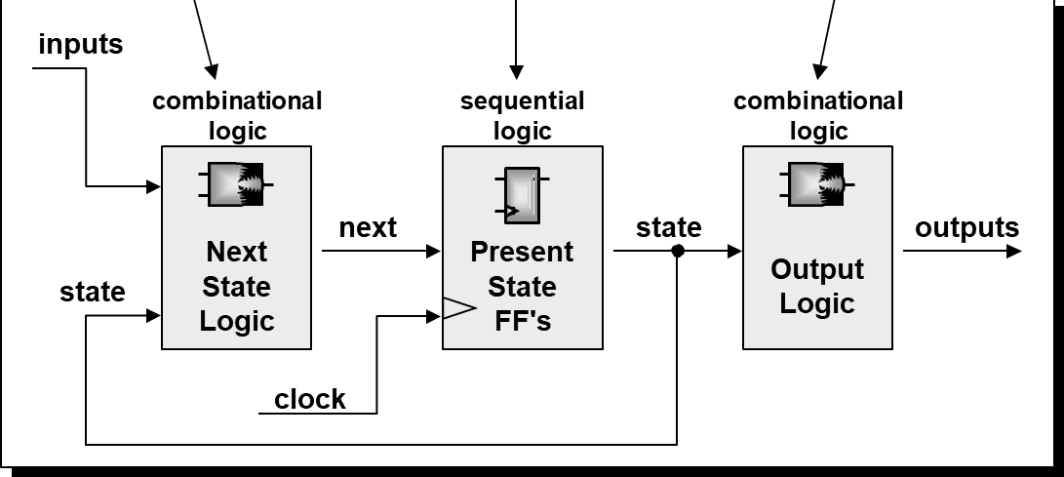
Two always block
always_comb begin //next state and output logic
next = 'bx;
rd = 1'b0;
ds = 1'b0;
case (state)
IDLE : if (go) next = READ;
else next = IDLE;
READ : begin
rd = 1'b1;
next = DLY;
end
DLY : begin
rd = 1'b1;
if (!ws) next = DONE;
else next = READ;
end
DONE : begin
ds = 1'b1;
next = IDLE;
end
endcase
end
endmodule
module fsm_cc1_2
(output logic rd, ds,
input go, ws, clk, rst_n);
//binary encoding
parameter IDLE = 2'b00,
READ = 2'b01,
DLY = 2'b11,
DONE = 2'b10;
logic [1:0] state, next;
always_ff@(posedge clk, negedge rst_n)
if (!rst_n) state <= IDLE;
else state <= next;

Slide 16

1. State definition
module fsm_cc1_2
(output logic rd, ds,
input go, ws, clk, rst_n);
parameter IDLE = 2'b00,
READ = 2'b01,
DLY = 2'b11,
DONE = 2'b10;
logic [1:0] state, next;
always_ff@(posedge clk, negedge rst_n)
if (!rst_n) state <= IDLE;
else state <= next;
State assignment? Synopsys FSM compiler can help
Notes:
參數定義

Slide 17





Why not use define? It’s a global varaible
`define
IDLE
3'b000
`define
IDLE
2'b00
`define
`define
`define
`define
B1 3'b001
B2 3'b010
B3 3'b101 READ 3'b100
"Re-definition" warnings!
`define
`define
READ 2'b01 S2 2'b10
module fsm2
...
( ... );
module fsm1
...
endmodule
( ... );
Multiple FSMs with the same state names
endmodule
Bad coding
style!!
IDLE
IDLE
READ
B1
`define creates a global definition
B3
B2
S2
READ
Notes:
為何不建議用define? define是global variable，容易互相干擾

Slide 18





State definition: use parameter (local variable)
module fsm1 ( ... );
module fsm2
...
( ... );
...
parameter
IDLE = 3'b000, B1 = 3'b001,
B2 = 3'b010,
B3 = 3'b101, READ = 3'b100;
No state definition problems!
parameter | IDLE | = | 2'b00,
 | READ | = | 2'b01,
 | S2 | = | 2'b10;
Multiple FSMs with the same state names
...
endmodule
Good coding
...
style!!
endmodule
IDLE
IDLE
READ
B1
parameters create local definitions
B3
B2
S2
READ

Slide 19
2. Present state DFF
module fsm_cc1_2
(output logic rd, ds,
input go, ws, clk, rst_n);
parameter IDLE = 2'b00,
READ = 2'b01,
DLY = 2'b11,
DONE = 2'b10;
logic [1:0] state, next;
always_ff@(posedge clk, negedge rst_n)
if (!rst_n) state <= IDLE;
else state <= next;
State variable
Remember to add reset state

Slide 20
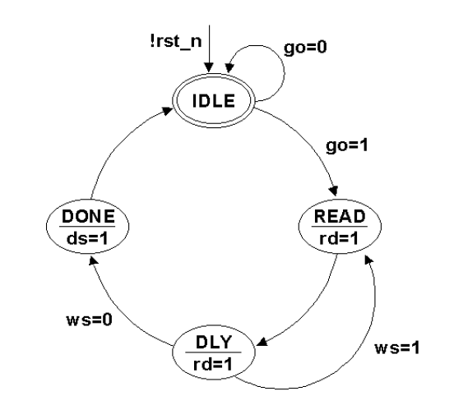
3. Next state/ output logic
always_comb begin //next state and output logic
next = 'bx;
rd = 1'b0;
ds = 1'b0;
case (state)
IDLE : if (go) next = READ;
else next = IDLE;
READ : begin
rd = 1'b1;
next = DLY;
end
DLY : begin
rd = 1'b1;
if (!ws) next = DONE;
else next = READ;
end
DONE : begin
ds = 1'b1;
next = IDLE;
end
endcase
end
endmodule
Default case
Use ’bx for logic min
每個case item放不同state
Test each state
Test input conditions
Output logic
Assign next state output

Slide 21
State Encoding: Binary Encoding
Straight encoding of states
S0=“00” S1=“01” S2=“10” S3=“11”
For n states, there are ceiling(log₂(n))flip-flops needed
This gives the least numbers of flip-flops
Good for “Area” constrained designs
Number of possible illegal states = 2^{[log2 (n)]}–n
Drawbacks:
Multiple bits switch at the same time = Increased noise and power
Next state logic is multi-level = Increased power and reduced speed

Slide 22
State Encoding:Gray-Code Encoding
Encoding using a gray code where only one bits switches at a time
S0=“00” S1=“01” S2=“11” S3=“10”
For n states, there are ceiling(log₂(n)) flip-flops needed
This gives low power and noise due to only one bit switching
Good for “power/noise” constrained designs
Number of possible illegal states = 2^{[log2 (n)]}–n
Drawbacks:
The next state logic is multi-level = Increased power and reduced speed

Slide 23
State Encoding: One-Hot Encoding
Encoding one flip-flop for each state
S0=“0001” S1=“0010” S2=“0100” S3=“1000”
For n states, there are n flip-flops needed
The combination logic is one level (i.e., a decoder)
Good for speed
Especially good for FPGA due to “Programmable Logic Block”
Number of possible illegal states = 2^{n}–n
Drawbacks:
Takes more area

Slide 24








State Encoding: Trade-Offs
Typically trade off Speed, Area, and Power
One-Hot
Speed
Area Binary
Power
Gray

Slide 25
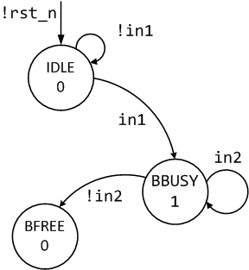
Two Always Coding Styles
One of the best Verilog coding styles
Code the FSM design using two always blocks,
One for the sequential state register
One for the combinational next-state and combinational output logic.
parameter [1:0]
IDLE=2'b00, BBUSY=2'b01,BFREE=2'b10;
reg [1:0] state, next;
always @(posedge clk or negedge rst_n) if (!rst_n) state <= IDLE;
else state <= next;
always @(state or in1 or in2) begin next = 2'bx; out1 = 1'b0;
case (state)
IDLE : | if (in1) | next | = | BBUSY;
 | else | next | = | IDLE;
BBUSY: | begin
out1 = 1'b1;
if (in2) next = BBUSY; else next = BFREE; end
//... endcase end
Combinational logic 和sequential logic 分開

Slide 26
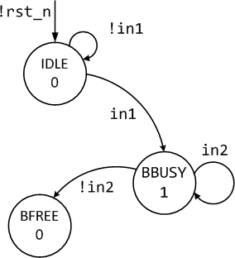
One Always Block FSM Style (Avoid This Style!)
One of the most common FSM coding styles in use today
It is more verbose
It is more confusing
It is more error prone (comparable two always block coding style)
parameter [1:0]
IDLE=2'b00, BBUSY=2'b01,BFREE=2'b10;
reg [1:0] state;
always @(posedge clk or negedge rst_n) if (!rst_n) begin
state <= IDLE;
out1 <= 1'b0;
end
else begin
state <= 2'bx; case (state)
out1 <= 1'b0;
IDLE : if (in1) begin
state <= BBUSY;
out1 <= 1'b1; end
else
state <= IDLE;
BBUSY: if (in2) begin
state <= BBUSY;
out1 <= 1'b1;
end
else state <= BFREE;
endcase
Combinational logic 和sequential logic 放在一起

Slide 27






One Always Block FSM Style (Avoid This Style!)
A declaration is made for state. Not for next.
The state assignments do not correspond to the current state of the case statement, but the state that case statement is transitioning to.
This is error prone (but it does work if coded correctly).
parameter [1:0]
IDLE=2'b00, BBUSY=2'b01,BFREE=2'b10;
reg [1:0] state;
1
always @(posedge clk or negedge rst_n) if (!rst_n) begin
state <= IDLE;
out1 <= 1'b0; end
else begin
state <= 2'bx; case (state)
out1 <= 1'b0;
IDLE : if (in1) begin
state <= BBUSY;
2
out1 <= 1'b1; end
else
state <= IDLE;
BBUSY: if (in2) begin
state <= BBUSY;
out1 <= 1'b1; end
else state <= BFREE;
endcase end
Notes:
state <= BBUSY;
中的state指的是下一個要變過去的state
和case 的state 是不一樣的 (不同cycle)

Slide 28






One Always Block FSM Style (Avoid This Style!)
There is just one sequential always block, coded using nonblocking assignments.
All outputs will be registered (unless the outputs are placed into a separate combinational always block or assigned using continuous assignments).
No asynchronous Mealy outputs can be generated from a single synchronous always block.
parameter [1:0]
IDLE=2'b00, BBUSY=2'b01,BFREE=2'b10;
reg [1:0] state;
3
always @(posedge clk or negedge rst_n) if (!rst_n) begin
state <= IDLE;
out1 <= 1'b0; end
else begin
state <= 2'bx; case (state)
out1 <= 1'b0;
IDLE : if (in1) begin
state <= BBUSY;
4
out1 <= 1'b1; end
else
state <= IDLE;
BBUSY: if (in2) begin
state <= BBUSY;
out1 <= 1'b1; end
else state <= BFREE;
endcase end

Slide 29












Index into the state register, not state encodings
Onehot requires larger declarations
State reset, set to 1 the IDLE bit
Next state assignment must make all-0's
parameter [1:0] IDLE=0, BBUSY=1, BFREE=2;
1
reg [2:0] state, next;
2
always @(posedge clk or negedge rst_n) if (!rst_n) state <= 3’b001;
3
else state <= next;
always @(state or in1 or in2) begin
4
next = 3’b000; out1 = 1'b0;
case (1’b1)
state[IDLE] : if (in1) next[BBUSY] = 1’b1;
else next[IDLE] = 1’b1; state[BBUSY]: begin
out1 = 1'b1;
if (in2) next[BBUSY] = 1’b1;
else next[BFREE] = 1’b1; end
//... endcase end

Slide 30
TLDR
Use two always or three always coding style
Two always: one for state DFF, one for next state and output
Three always: one for state DFF, one for next state, one for output

Slide 31
如何在Debussy / Verdi顯示state名稱幫助debug
http://www.cnblogs.com/oomusou/archive/2011/06/14/verdi_fsm_state.html
Notes:
http://www.cnblogs.com/oomusou/archive/2011/06/14/verdi_fsm_state.html

Slide 32
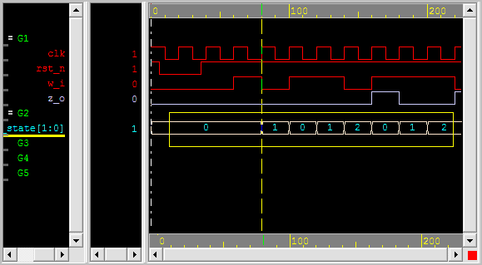
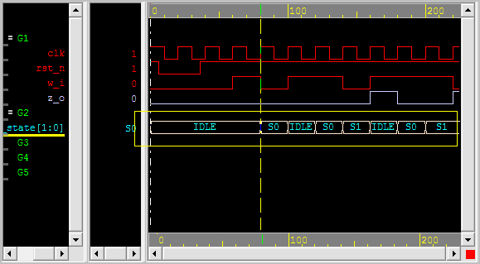
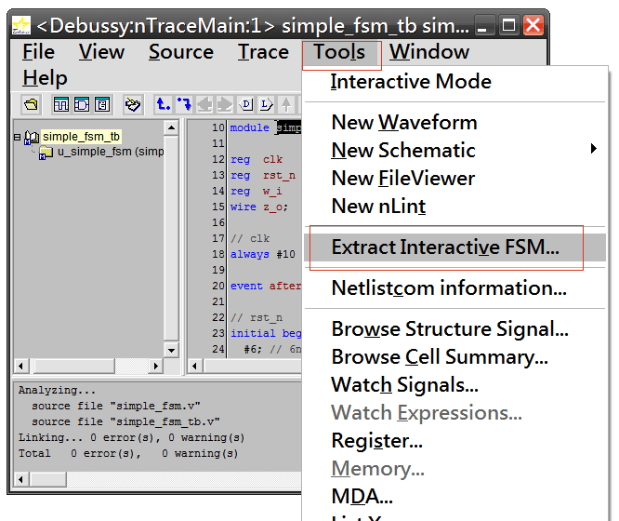
使用前，讀進*.fsdb檔後，FSM state信號，預設只會顯示
state encoding所代表的數值
若能顯示state名稱，相信可讀性更高，更方便debug
Tools –> Extract Interactive FSM…

